Slide 1
Data Clinic
a work in progress
Clinical Lead: Tim Bonnici
BIPs: David Egan & Tracey Crissell
Data Sci Fellows: Dan Stein, Conor Foley

Slide 2

Overview
Context
Aims of the data clinic
Preliminary survey
Our current process
An example of our work
View to the future

Slide 3
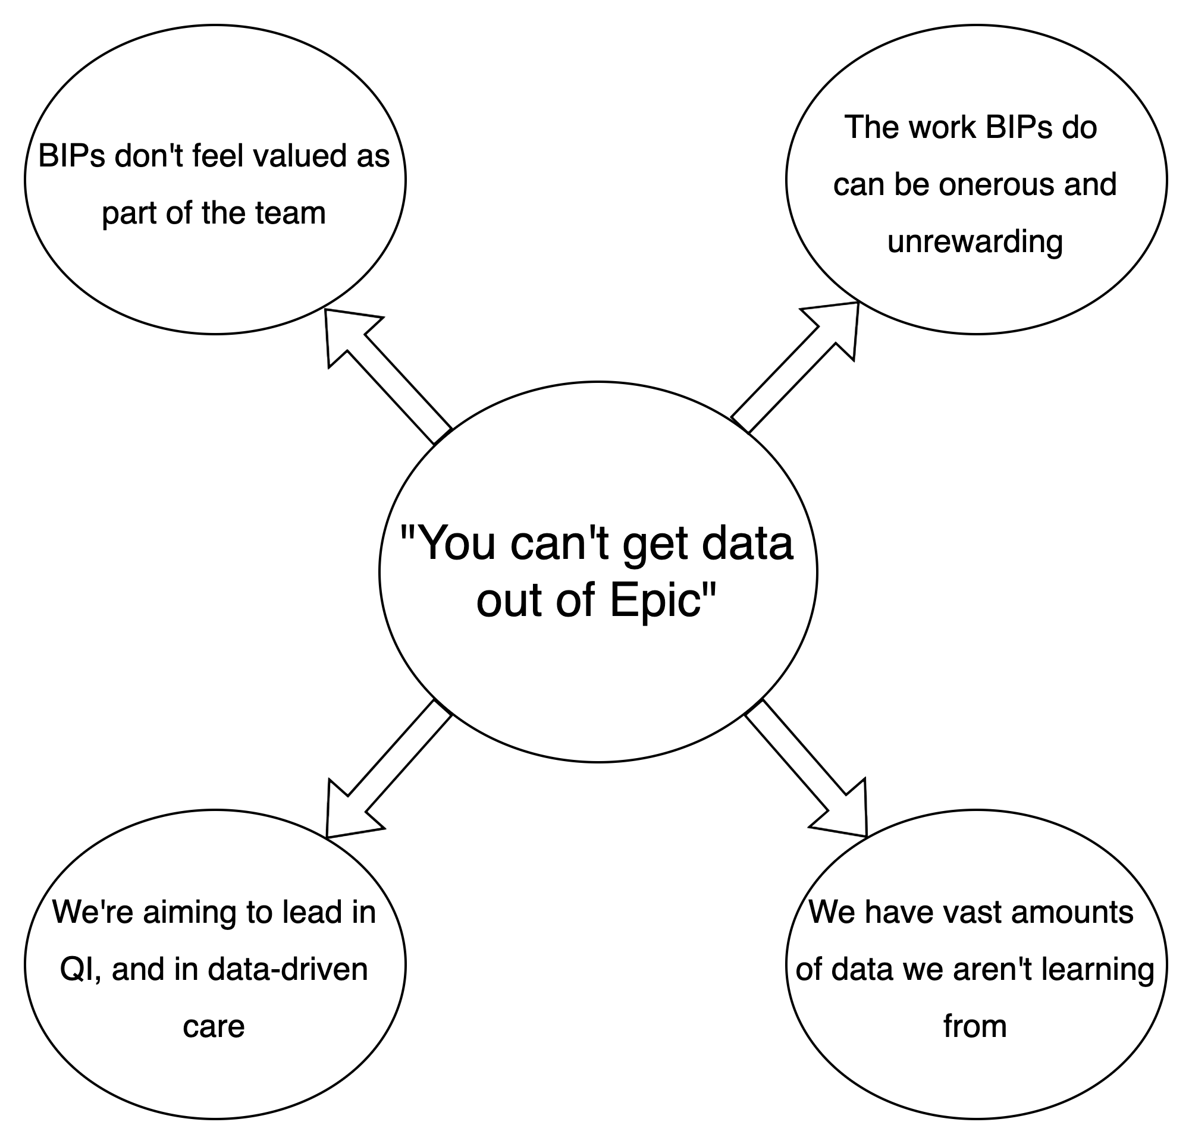
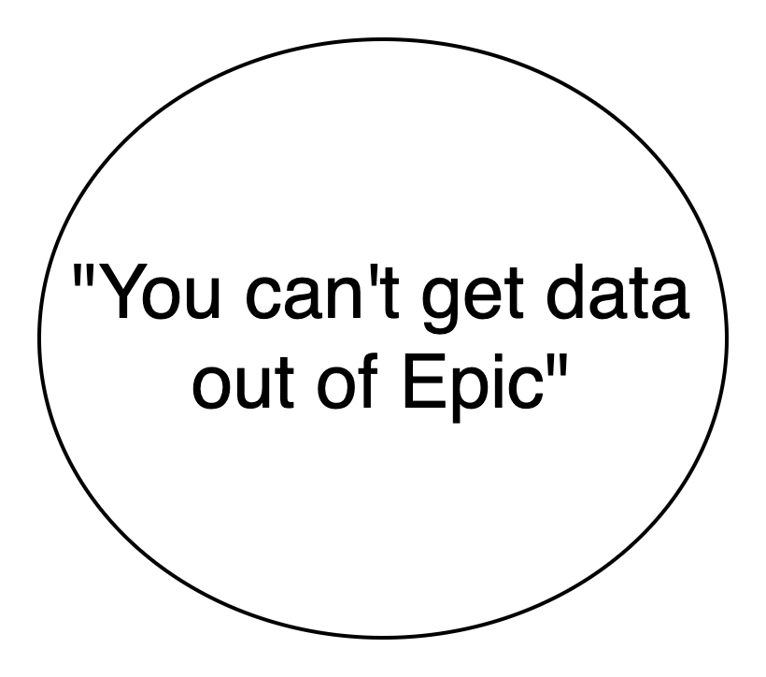
Outlining the problem
Notes:
Clinicians believe it is hard to access clinical data for audit and QI
Analysts find the process of servicing requests onerous and sometimes unrewarding
Conversations between clinicians and analysts are beset by lack of clinician’s understanding of the data, and unrealistic expectations
UCLH ICU is aiming to be a leader in both QI and data-driven care
We are re-imagining our QI programme to increase effectiveness
Our data clinic sits at the heart of this

Slide 4




A small preliminary survey
Job Role:
3
Consultants
11
Junior doctors
2
Nurses
3
Other
Modal time at UCLH: Over 1 year (58%)
N = 19

Slide 5
Barriers to completing projects
All but one respondent ranked collection as a barrier
Analysis is also a challenge

Slide 6
Do people know about us?
Barriers to getting data →
Answer: no!

Slide 7
What are people’s expectations?
What types of data can you request?
52.6 % - No idea
47.4% - Demographics / LOS etc
42.1% - MRN numbers / Lab results / Flowsheet data / Times (documentation, orders, medications)
15.8% - Free text data
5.3% - Diagnoses
In short: unrealistic

Slide 8
What can we conclude from the survey?
There is a need for our service
There is a need to improve understanding of the analytics team
Data literacy amongst clinicians
Visibility of the analyst team
Expectations may be unrealistic

Slide 9
Aims of the data clinic
Central aim is to improve patient care through better access to data
How do we do this? Our strategy:
Improving access
Speed, accuracy, volume
Those who need it most
Pipe dream → Self service? Upskilling? Teach a wo/man to fish?
Aid interpretation of data
Engender a data-driven culture
Ensure high quality data
Data literacy
Champion BI team as an integral part of the ICU

Slide 10
Pre-mortem
Access
Capacity is a bottleneck
Understanding
Poor quality data is misunderstood
People
This increases, not decreases BIP workload
The process isn’t enjoyable, or rewarding

Slide 11
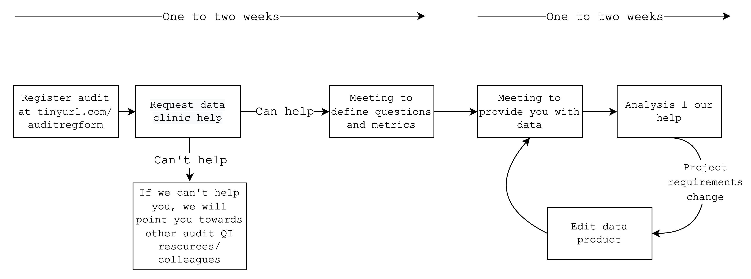
Structure & Process

Slide 12

What are your project aims?
Where can data not help you?
What is your population?
How can we improve management of sedation in ICU?
What is the data quality like?
What are your metrics and how do define them?
Where are the data stored?
What did we do? – an example
Notes:
Example project: the sequence of questions we go through with investigators

Slide 13



Notes:
Multiple potential outputs/data products

Slide 14
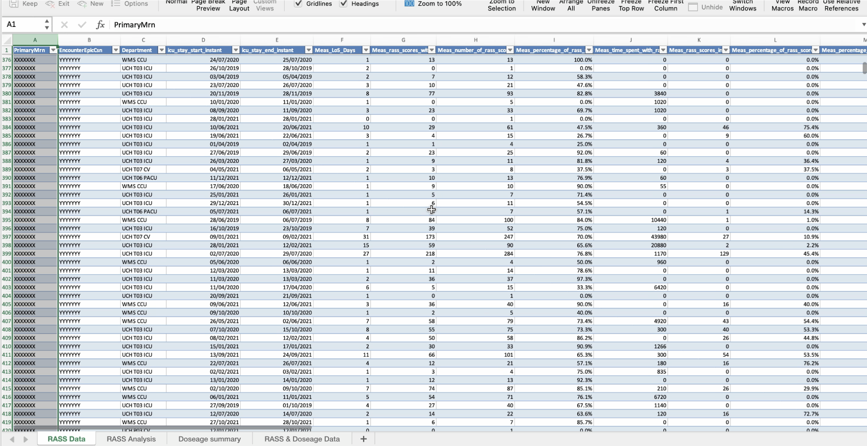
Notes:
Data overwhelming for some clinicians – need analytics support or a simplified project

Slide 15
What did we do? – an example
Notes:
Insights provided by David for investigators
Real time reporting into dashboards
Simple from a data engineer’s POV, but an example of where front-line healthcare is years behind

Slide 16

Investigators
”Amazing amount of data provided…
…far faster than [we] could have accessed manually”
“The process of going through and breaking down our project made it much more robust”
David
“In the past it would be a stream of emails, which could last months … a lot got lost in translation”
“Easier to understand what data people are asking for”
“What happens with the data provided is much clearer now”
Me/Dan/Tim
”We learnt how we can change the front-end to improve data quality”
”This has shown us what we need to do to have the BIPs’ work recognised across the ICU team”
What happened?
Notes:
Patient as the centre of our aims

Slide 17
Outcomes
7 projects supported
Procedure and access route documented
Modularised scripts documented
Interest from other sectors
Presented nationally; soon to be internationally

Slide 18
Pre-mortem
Access
Capacity is a bottleneck
Understanding
Poor quality data is misunderstood
People
This increases, not decreases BIP workload
The process isn’t enjoyable, or rewarding

Slide 19
Lessons learned
Need for audit & QI support before data
More data is not always the answer
Data visualisation & delivery needs development
Data quality needs to be understood & improved
Collaboration is key

Slide 20
The five year plan
Process transformation through a data-driven approach
Quality of work recognised externally
Data team recognised as a genuinely valuable part of running ICU–move from extracts to analytics
People can unquestioningly trust the accuracy of the outputs we produce
People understand how to request data and outputs are produced in a timely fashion. Capacity to serve demand is not a significant bottleneck
The undiscovered future
Year 2-5 goals
Year 1 goals
Courtesy Tim Bonnici
Notes:
Themes
What we do with the data we give people?
How we learn from it as a data clinic. Can we improve data quality?
Collaboration
Embedding BIPs in your community and championing their work

Slide 21
Any questions?
Get in touch:
Conor Foley – conor.foley@nhs.net
Tim Bonnici – t.bonnici@nhs.net
David Egan – david.egan@nhs.net
Tracey Crissell – traceycrissell@nhs.net

